Slide 1

Q&A PLATFORM FOR EDUCATORS
Supervisor: Mr. Nguyen Huy Hung
Team members: Kha Hoang Minh (Leader) Truong Nhu Khang

Slide 2

Out line
Q&A Platform for Educators
1. Scenario Problem
2. Our Solution
3. Scope
4. Demonstration
5. Future plan
6. Q & A

Slide 3
Q&A Platform for Educators
SCENARIO PROBLEM

Slide 4

Q&A Platform for Educators
Scenario Problem
Feeling shy when asking at school

Slide 5

Q&A Platform for Educators
Scenario Problem
Lack of school’s time

Slide 6

Q&A Platform for Educators
Scenario Problem
Ideas from experienced people or professionals

Slide 7




Q&A Platform for Educators
Scenario Problem
Need true teaching & studying environment

Slide 8
Q&A Platform for Educators
OUR SOLUTION

Slide 9

Q&A Platform for Educators
OUR Solution
Student
Students
Beginners
People who want to broaden their knowledge

Slide 10

Q&A Platform for Educators
OUR Solution
Teacher
Teachers
Lecturers
Experienced people or professionals

Slide 11


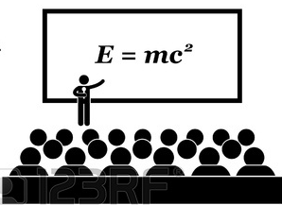



Q&A Platform for Educators
OUR Solution
owns
Teacher A’s classroom
is invited to
Teacher A
Student A
requests to join
belongs to
is invited to answer
Question
Teacher B
Student B

Slide 12
Q&A Platform for Educators
SCOPE

Slide 13
Q&A Platform for Educators
SCOPE
Features
Teacher
Student

Slide 14

Q&A Platform for Educators
SCOPE | Features
Post a question & answer a question

Slide 15

Q&A Platform for Educators
SCOPE | Features
Require and accept an answer

Slide 16

Q&A Platform for Educators
SCOPE | Features
Follow teacher

Slide 17
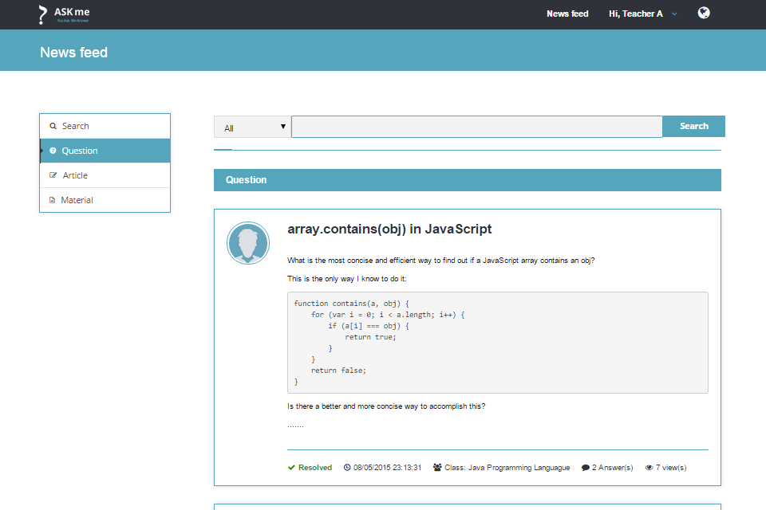
Q&A Platform for Educators
SCOPE | Features
News feed

Slide 18
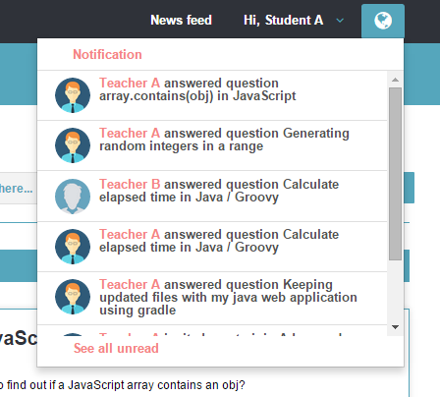
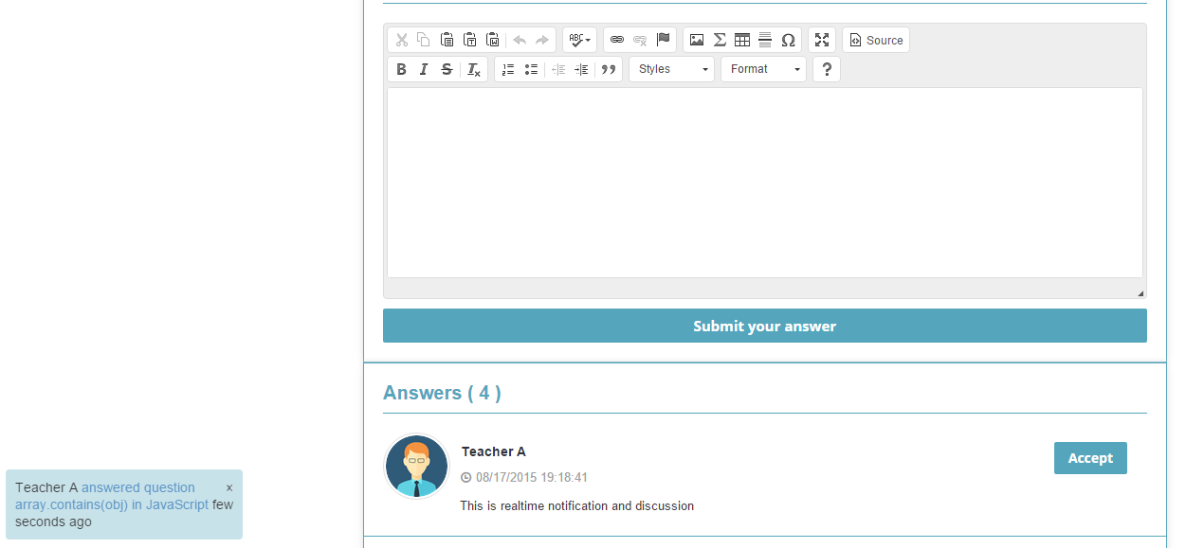
Q&A Platform for Educators
SCOPE | Features
Real time notification and discussion

Slide 19
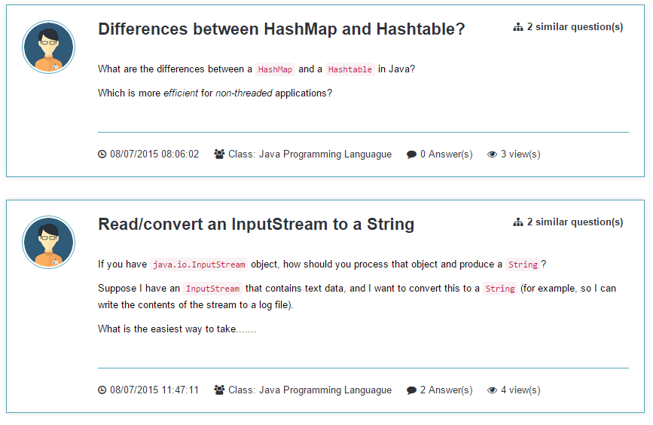

Q&A Platform for Educators
SCOPE | Features
Suggest mergeable questions

Slide 20
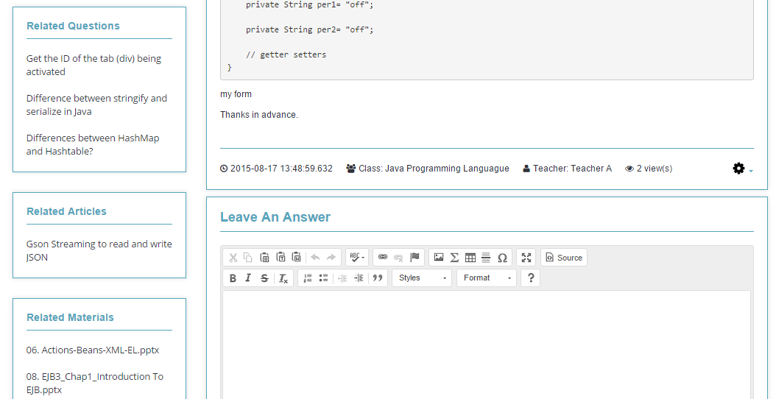
Q&A Platform for Educators
SCOPE | Features
Suggest related questions, articles and materials

Slide 21
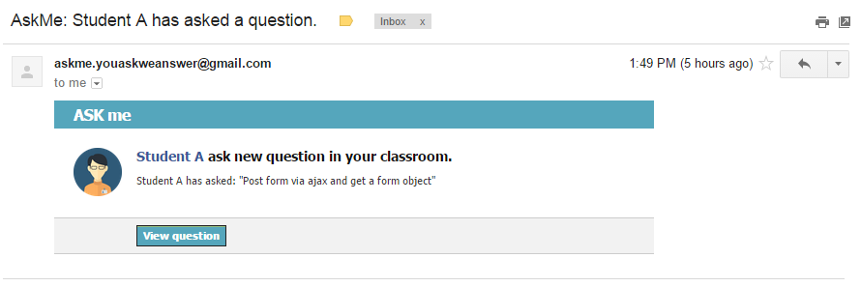
Q&A Platform for Educators
SCOPE | Features
Notify the teacher via e-mail

Slide 22


Q&A Platform for Educators
SCOPE | Student
Request to join classroom
Add material to folder

Slide 23




Q&A Platform for Educators
SCOPE | Teacher
Manage classroom
Invite student or teacher
Upload material
Merge questions

Slide 24
Q&A Platform for Educators
DEMONSTRATION

Slide 25





Q&A Platform for Educators
News feed
View
Display
Student
View
System
News feed screen
Update list of questions every 30 minutes
Provide ordered list of questions
Teacher

Slide 26
Q&A Platform for Educators
News feed| Algorithm
Problems: How to display suitable questions for each individual user?
Solution: Evaluate question’s score base on the importance of a question.

Slide 27
Q&A Platform for Educators
News feed| Algorithm (1/4)
Step 1: Separate questions into 3 groups

Slide 28
Q&A Platform for Educators
News feed| Algorithm (1/4)
Questions belong to joined classrooms or owned classrooms
More important
Questions belong to followed teachers
Questions belong to user’s specialty
Less important

Slide 29
Q&A Platform for Educators
News feed| Algorithm (2/4)
Step 2: Calculate question’s score

Slide 30
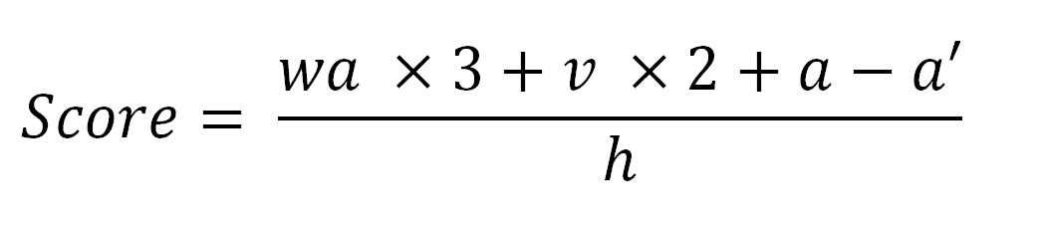
Q&A Platform for Educators
News feed| Algorithm (2/4)
For each question in a group, question’s score is calculated based on:

Slide 31
Q&A Platform for Educators
News feed| Algorithm (3/4)
Step 3: Save to Redis DB

Slide 32
Q&A Platform for Educators
News feed| Algorithm (4/4)
Step 4: Get ordered list of question from Redis DB

Slide 33


Q&A Platform for Educators
Create classroom & invite student
Create
Teacher A
Send
Classroom: C++ Programming Language
Invitation
Pending
Accepted
Ignored
Notify
Invitation (to join classroom)
Student A

Slide 34
Q&A Platform for Educators
Create classroom & invite student
Create
Teacher A
Send
Classroom: C++ Programming Language
Invitation
Pending
Accepted
Ignored
Notify
Invitation (to join classroom)
Student A

Slide 35
Q&A Platform for Educators
Create classroom & invite student
Create
Teacher A
Send
Classroom: C++ Programming Language
Invitation
Pending
Accepted
Ignored
Notify
Invitation (to join classroom)
Student A

Slide 36
Q&A Platform for Educators
Create classroom & invite student
Create
Teacher A
Send
Classroom: C++ Programming Language
Notify
Accept
Invitation (to join classroom)
Student A

Slide 37

Q&A Platform for Educators
REQUEST TO JOIN
Send
Student A
Request to join classroom: Java programming language
Notify
Request
Pending
Accepted
Ignored
Teacher A

Slide 38
Q&A Platform for Educators
REQUEST TO JOIN
Send
Student A
Request to join classroom: Java programming language
Notify
Request
Pending
Accepted
Ignored
Teacher A

Slide 39
Q&A Platform for Educators
REQUEST TO JOIN
Send
Student A
Request to join classroom: Java programming language
Notify
Request
Pending
Accepted
Ignored
Teacher A

Slide 40
Q&A Platform for Educators
REQUEST TO JOIN
Send
Student A
Request to join classroom: Java programming language
Notify
Accept
Teacher A

Slide 41

Q&A Platform for Educators
Create Question
Create
Question (in Teacher A’s Java classroom)
Student A
Notify
Teacher A

Slide 42


Q&A Platform for Educators
ANSWER (REAL TIME), Accept AN ANSWER & REQURIE answers
Notify
Leave
Accept
Teacher A
An Answer (for Student A’s question)
Student A
Require answers
Notes:
Giáo viên sẽ vào trả lời câu hỏi . Nếu hs thấy câu trả lời hợp lý thì có thể bấm nút accept , nếu ko thì có thể nhấn vào ô want answer để giáo viên đứng lớp ưu tiên tìm cách trả lời câu hỏi .

Slide 43
Q&A Platform for Educators
invite another teacher
Send
Notify
Invitation (to answer Nguyen A’s question)
Teacher A
Teacher B
Notify
Leave
Accept
Student A
An Answer (for Nguyen A’s question)
Notes:
Nếu giáo viên ko rõ câu trả lời thì có thể mời một giáo viên khác vào hỗ trợ . Học sinh nếu đồng ý với câu trả lời thì có thể nhấn accept để cho bik rang câu hỏi đã được giải quyết

Slide 44

Q&A Platform for Educators
REAL Time notification & discussion
Subscriber
(user)
deliver
Publisher
(System)
Topic
(class,question,article,user)
register
publishes
register
deliver
Subscriber
(user)
Notes:
He thong gom 3 thanh phan : publisher ( he thong web ) . Topic ( co the la mot lop hoc , mot cau hoi , hoac la mot nguoi dung ) . Subscriber ( la nguoi dung cuoi ) .
Subscriber dang ki theo doi mot topic ( o day viec dang ky co the la gia nhap mot lop hoc ) . Sau do neu nhu co mot cau hoi duoc tao ra trong lop hoc . Thi he thong se gui thong tin cau hoi vua duoc tao ra toi topic tuong ung , sau do topic se chuyen lai thong tin cau hoi toi cai nguoi dung da dang ki theo doi topic

Slide 45



Q&A Platform for Educators
Merge questions
Select questions
Merge
Teacher A
List of questions suggested by System
Merging
Notify
List of students
Notes:
Để giúp giáo viên tiện lợi trong việc quản lý các câu hỏi và tránh sự trùng lặp giữa các câu hỏi , tôi có đưa ra chức năng gộp câu hỏi và trả lời một lúc nhiều câu hỏi .

Slide 46
Q&A Platform for Educators
Merge| Algorithm
Set A
Result
A1 = What is abstraction in OOP
A2 = How to convert String to Int
A3 = What is inheritance in OOP
A4 = How to parse String to Int
A4 = How to parse String to Int
A2 = How to convert String to Int
A1 = What is abstraction in OOP
A3 = What is inheritance in OOP
Notes:
Thuat toan sap xep cac tieu de cau hoi dua tren su giong nhau ve mat noi dung, nhung tieu de cau hoi co noi dung tuong tu nhau se duoc sap xep gan nhan .

Slide 47
Q&A Platform for Educators
merge| Algorithm (1/3)
Step 1: Calculate similarity between each two elements in Set A
Notes:
Diem giong nhau la bieu hien cho su giong nhau ve mat noi dung cua 2 chuoi, diem giong nhau cang cao thi 2 chuoi co noi dung can giong nhau .

Slide 48
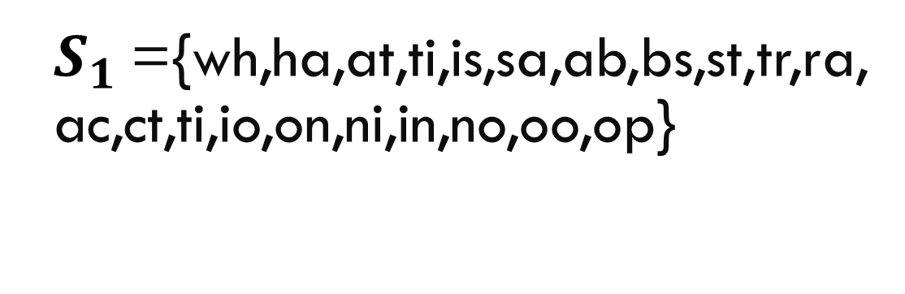
Q&A Platform for Educators
merge| Algorithm (1/3)
A1 = What is abstraction in OOP
$S_{1}$={wh,ha,at,ti,is,sa,ab,bs,st,tr,ra,ac,ct,ti,io,on,ni,in,no,oo,op}
Notes:
Dau tien chung se chia chuoi thu nhat thanh mot tap hop cac phan tu goi la S1 , moi phan tu bao gom 2 ki tu duoc chia ra tu chuoi mot cach tuan tu

Slide 49
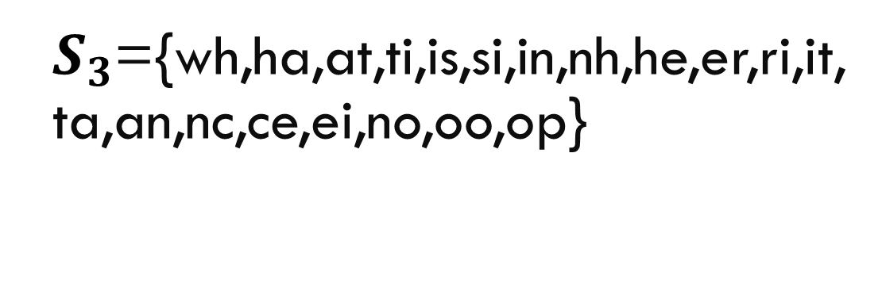
Q&A Platform for Educators
merge| Algorithm (1/3)
A3 = What is inheritance in OOP
$S_{3}$={wh,ha,at,ti,is,si,in,nh,he,er,ri,it,ta,an,nc,ce,ei,no,oo,op}

Slide 50

Q&A Platform for Educators
merge| Algorithm (1/3)
Find number of elements of $S_{1}∩S_{3}$ $$element\left(S_{1}∩S_{3}\right)=9$$
Notes:
{wh,ha,at,ti,is,in,no,oo,op} = 9

Slide 51

Q&A Platform for Educators
merge| Algorithm (1/3)
Find number of elements of $S_{1}∪S_{3}$ $$element\left(S_{1}∪S_{3}\right)=31$$
Notes:
{wh,ha,at,ti,is,in,no,oo,op,sa,ab,bs,st,tr,ra,ac,ct,io,on,ni,nh,he,er,ri,it,ta,an,nc,ce,ei} = 31

Slide 52
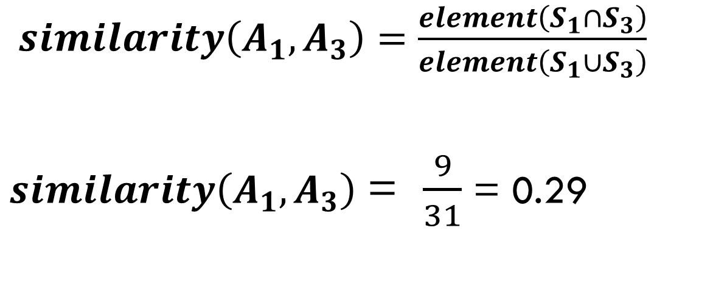
Q&A Platform for Educators
merge| Algorithm (1/3)
Calculate similarity
$similarity\left(A_{1},A_{3}\right)=\frac{element\left(S_{1}∩S_{3}\right)}{element\left(S_{1}∪S_{3}\right)}$
$similarity\left(A_{1},A_{3}\right)$ = $\frac{9}{31}$ = 0.29

Slide 53
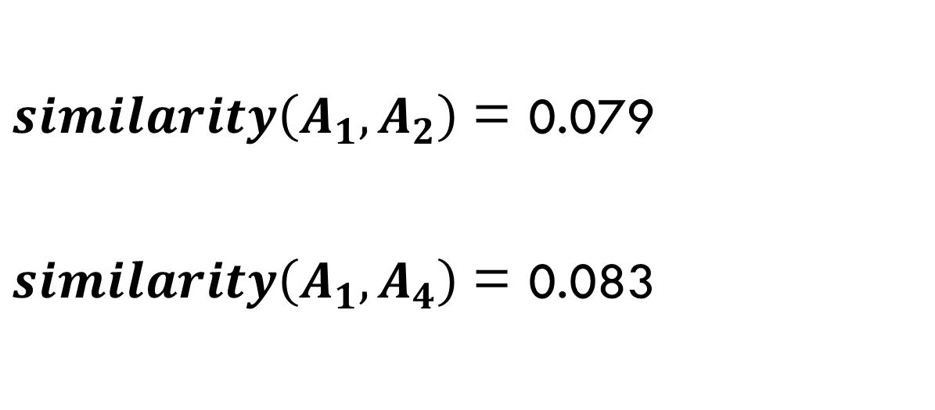

Q&A Platform for Educators
merge| Algorithm (1/3)
$similarity\left(A_{1},A_{3}\right)$ = 0.29
$similarity\left(A_{1},A_{2}\right)$ = 0.079
$similarity\left(A_{1},A_{4}\right)$ = 0.083
Notes:
Chung ta se tinh ra duoc diem going nhau cua 2 cap con lai

Slide 54
Q&A Platform for Educators
merge| Algorithm (2/3)
Step 2: Calculate score of each element in set A
Notes:
Tinh tong so diem giong nhau cua moi phan tu trong tap hop

Slide 55

Q&A Platform for Educators
merge| Algorithm (2/3)
$$score\left(A1\right)$$ $= similarity\left(A_{1},A_{2}\right)+similarity\left(A_{1},A_{3}\right)$+$similarity\left(A_{1},A_{4}\right)$
$$=0.079+0.29+0.083$$ $=0.452$

Slide 56
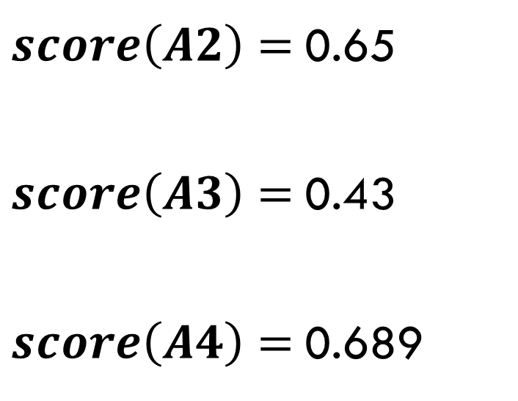

Q&A Platform for Educators
merge| Algorithm (2/3)
$score\left(A1\right)=$0.452
$score\left(A2\right)=$0.65
$score\left(A3\right)=$0.43
$score\left(A4\right)=$0.689
Notes:
O day chung ta tinh tong diem giong nhau cua tung phan tu .
Tong diem giong nhau cua A1 se bang so diem giong nhau cua A1,A2 + diem giong nhau A1,A3 + diem giong nhau cua A1,4
Ap dung cong thuc tinh diem giong nhau vua duoc de cap o tren . Chung ta se duoc ket qua nhu tren man hinh
Ap dung tuong tu cho cac phan tu con lai .

Slide 57
Q&A Platform for Educators
merge| Algorithm (3/3)
Step 3: Order set A by score ascending
Notes:
Sap xep lai tap hop A theo do giam dan cua tong diem going nhau

Slide 58
Q&A Platform for Educators
merge| Algorithm (3/3)
Result of set A
A4 = How to parse String to Int [0,689]
A2 = How to convert String to Int [0.65]
A1 = What is abstraction in OOP [0.452]
A3 = What is inheritance in OOP [0.43]

Slide 59

Q&A Platform for Educators
Upload material & Add material to folder
Upload
Add to folder
Material (in Teacher A’s classroom)
Teacher A
Student A
Notes:
Giáo viên có thể tải lên một tài liệu của mình trong một lớp học . Và học sinh có thể lưu lại thông tin tài liệu đó vào thư mục của mình

Slide 60
Q&A Platform for Educators
FUTURE PLAN

Slide 61



Q&A Platform for Educators
Future plan
Private classroom
Chatting
Android application

Slide 62
Q&A Platform for Educators
Q & A

